Slide 1
Chapter 4: Control Structures I (Selection)

Slide 2
Objectives
In this chapter, you will:
Learn about control structures
Examine relational and logical operators
Explore how to form and evaluate logical (Boolean) expressions
Discover how to use the selection control structures if, if...else, and switch in a program

Slide 3
Objectives (cont’d.)
Learn how to avoid bugs by avoiding partially understood concepts
Learn to use the assert function to terminate a program

Slide 4
Control Structures
A computer can proceed:
In sequence
Selectively (branch): making a choice
Repetitively (iteratively): looping
By calling a function
Two most common control structures:
Selection
Repetition

Slide 5
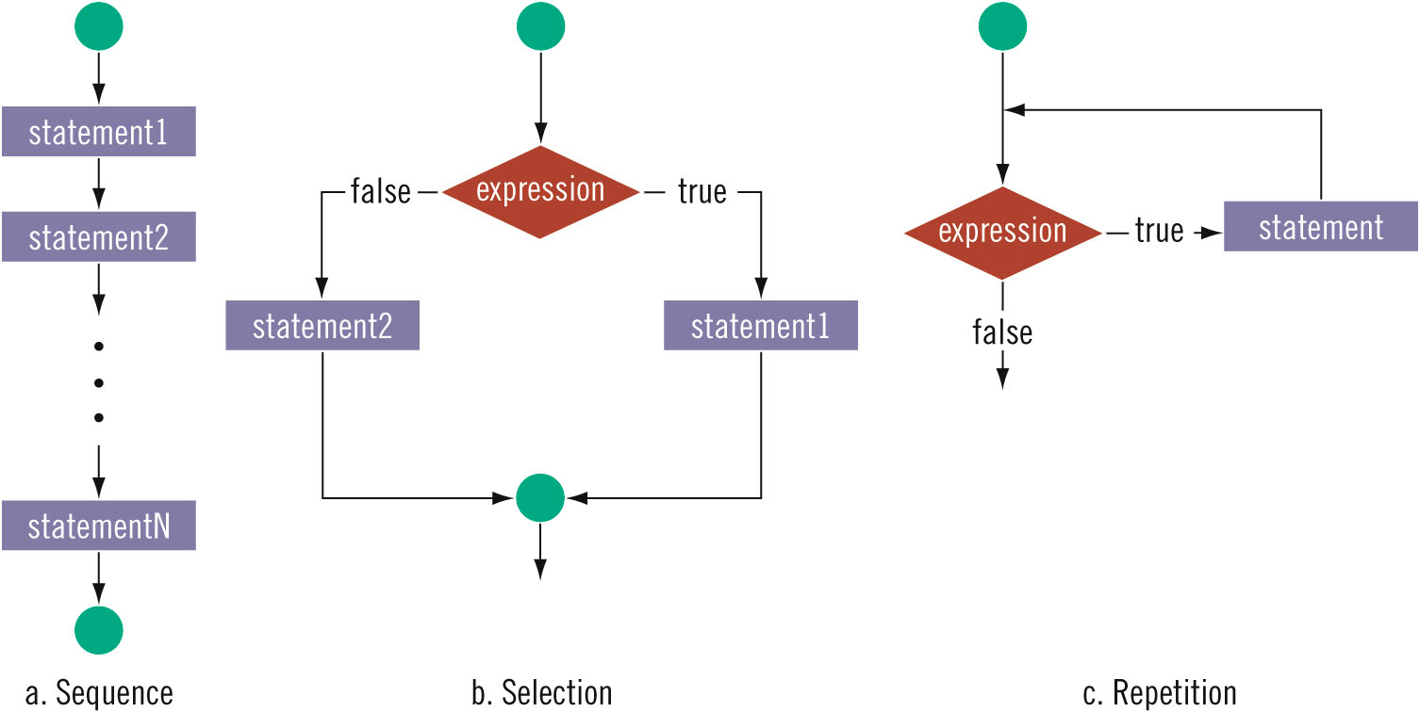
Control Structures (cont’d.)

Slide 6
Relational Operators
Conditional statements: only executed if certain conditions are met
Condition: represented by a logical (Boolean) expression that evaluates to a logical (Boolean) value of true or false
Relational operators:
Allow comparisons
Require two operands (binary)
Evaluate to true or false

Slide 7
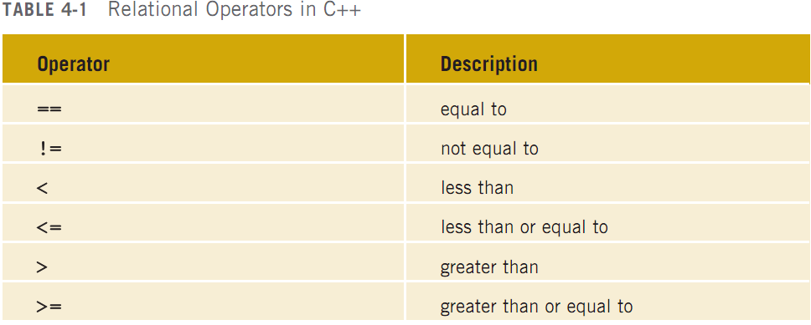
Relational Operators (cont’d.)

Slide 8
Relational Operators and Simple Data Types
Relational operators can be used with all three simple data types:
8 < 15 evaluates to true
6 != 6 evaluates to false
2.5 > 5.8 evaluates to false
5.9 <= 7.5 evaluates to true

Slide 9
Comparing Characters
Expression of char values with relational operators
Result depends on machine’s collating sequence
ASCII character set
Logical (Boolean) expressions
Expressions such as 4 < 6 and 'R' > 'T’
Returns an integer value of 1 if the logical expression evaluates to true
Returns an integer value of 0 otherwise

Slide 10
Relational Operators and the string Type
Relational operators can be applied to strings
Strings are compared character by character, starting with the first character
Comparison continues until either a mismatch is found or all characters are found equal
If two strings of different lengths are compared and the comparison is equal to the last character of the shorter string
The shorter string is less than the larger string

Slide 11
Relational Operators and the string Type (cont’d.)
Suppose we have the following declarations:
string str1 = "Hello";
string str2 = "Hi";
string str3 = "Air";
string str4 = "Bill";
string str4 = "Big";

Slide 12
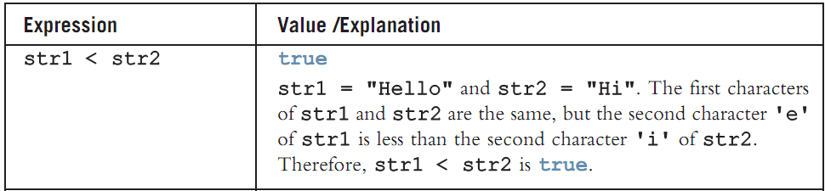
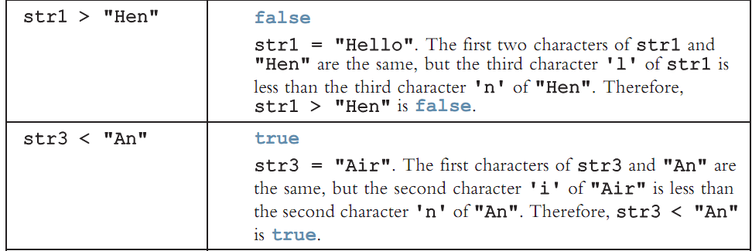
Relational Operators and the string Type (cont’d.)

Slide 13
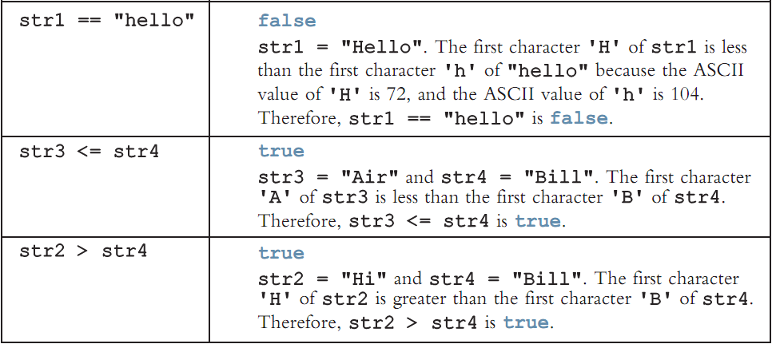
Relational Operators and the string Type (cont’d.)

Slide 14
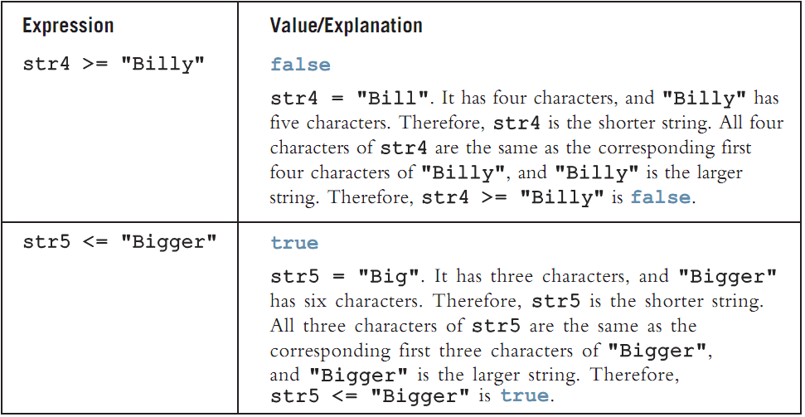
Relational Operators and the string Type (cont’d.)

Slide 15
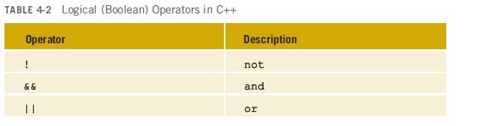
Logical (Boolean) Operators and Logical Expressions
Logical (Boolean) operators: enable you to combine logical expressions

Slide 16
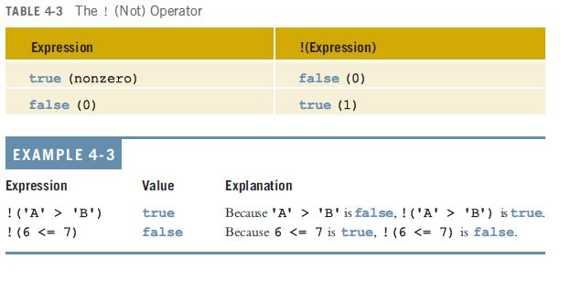
Logical (Boolean) Operators and Logical Expressions (cont’d.)

Slide 17
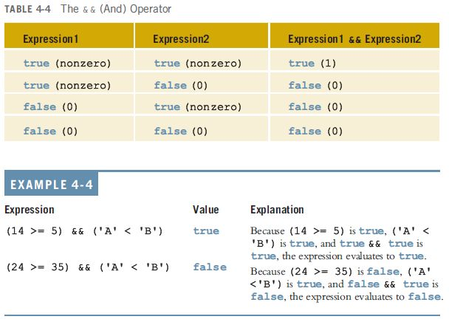
Logical (Boolean) Operators and Logical Expressions (cont’d.)

Slide 18
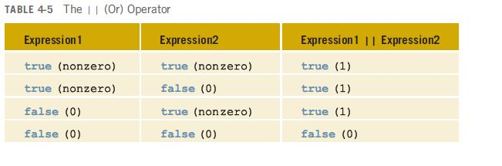
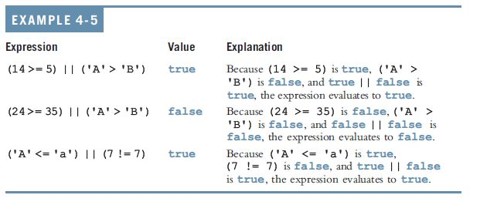
Logical (Boolean) Operators and Logical Expressions (cont’d.)

Slide 19
Order of Precedence
Relational and logical operators are evaluated from left to right
The associativity is left to right
Parentheses can override precedence

Slide 20
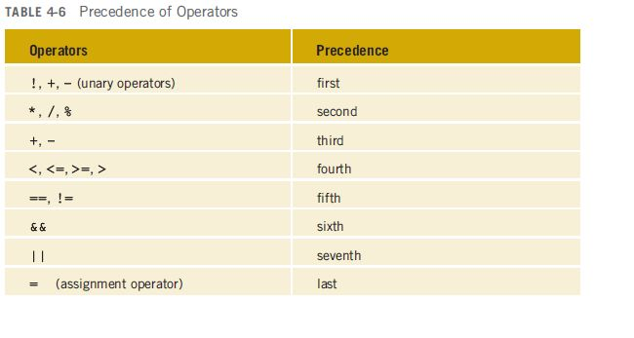
Order of Precedence (cont’d.)

Slide 21
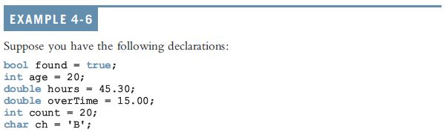
Order of Precedence (cont’d.)

Slide 22
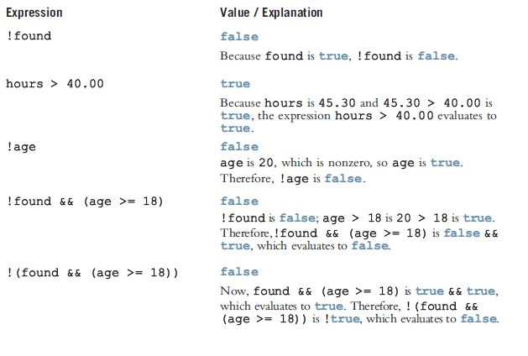
Order of Precedence (cont’d.)

Slide 23
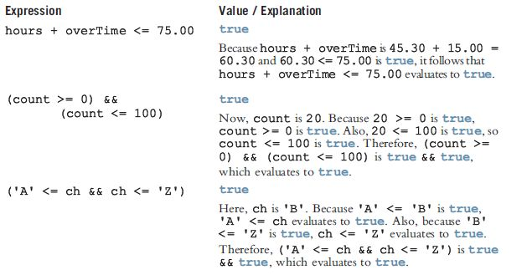
Order of Precedence (cont’d.)

Slide 24
The int Data Type and Logical (Boolean) Expressions
Earlier versions of C++ did not provide built-in data types that had Boolean values
Logical expressions evaluate to either 1 or 0
Logical expression value was stored in a variable of the data type int
Can use the int data type to manipulate logical (Boolean) expressions

Slide 25
The bool Data Type and Logical (Boolean) Expressions
The data type bool has logical (Boolean) values true and false
bool, true, and false are reserved words
The identifier true has the value 1
The identifier false has the value 0

Slide 26
Selection: if and if...else
if and if...else statements can be used to create:
One-way selection
Two-way selection
Multiple selections

Slide 27

One-Way Selection
One-way selection syntax:
Statement is executed if the value of the expression is true
Statement is bypassed if the value is false; program goes to the next statement
Expression is called a decision maker

Slide 28
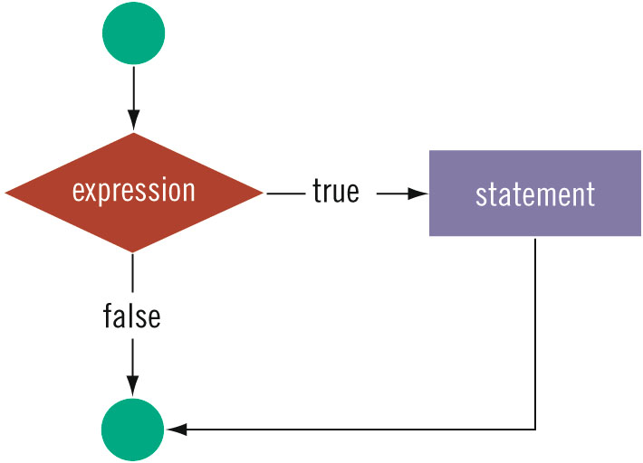
One-Way Selection (cont’d.)

Slide 29
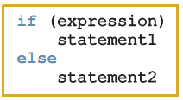
Two-Way Selection
Two-way selection syntax:
If expression is true, statement1 is executed; otherwise, statement2 is executed
statement1 and statement2 are any C++ statements

Slide 30
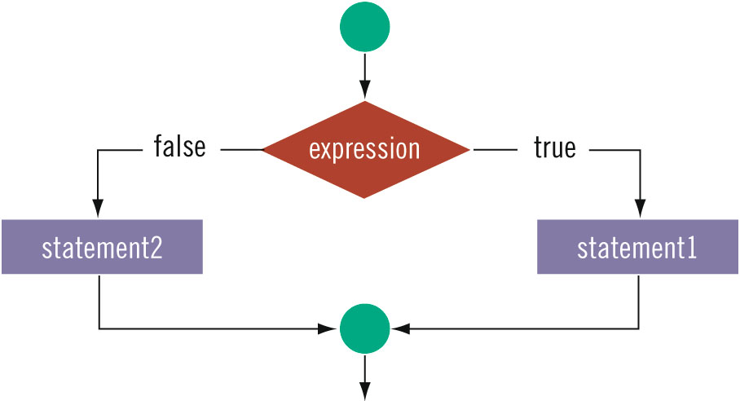
Two-Way Selection (cont’d.)

Slide 31
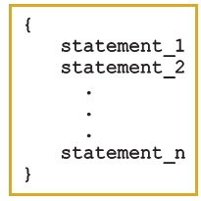
Compound (Block of) Statements
Compound statement (block of statements):
A compound statement functions like a single statement

Slide 32
Compound (Block of) Statements (cont’d.)
if (age > 18)
{
cout << "Eligible to vote." << endl;
cout << "No longer a minor." << endl;
}
else
{
cout << "Not eligible to vote." << endl;
cout << "Still a minor." << endl;
}

Slide 33
Multiple Selections: Nested if
Nesting: one control statement is located within another
An else is associated with the most recent if that has not been paired with an else

Slide 34
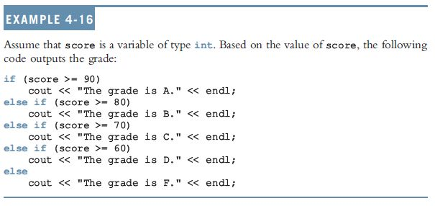
Multiple Selections: Nested if (cont’d.)

Slide 35
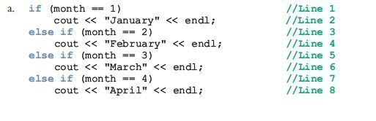

Comparing if…else Statements with a Series of if Statements

Slide 36
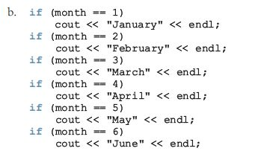
Comparing if…else Statements with if Statements (cont’d.)

Slide 37
Short-Circuit Evaluation
Short-circuit evaluation: evaluation of a logical expression stops as soon as the value of the expression is known
Example:
(age >= 21) || ( x == 5) //Line 1
(grade == 'A') && (x >= 7) //Line 2

Slide 38
Comparing Floating-Point Numbers for Equality: A Precaution
Comparison of floating-point numbers for equality may not behave as you would expect
Example:
1.0 == 3.0/7.0 + 2.0/7.0 + 2.0/7.0 evaluates to false
Why? 3.0/7.0 + 2.0/7.0 + 2.0/7.0 = 0.99999999999999989
Solution: use a tolerance value
Example: if fabs(x – y) < 0.000001

Slide 39
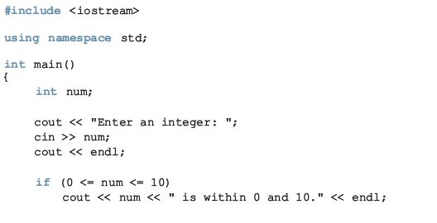
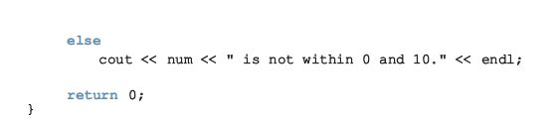
Associativity of Relational Operators: A Precaution

Slide 40
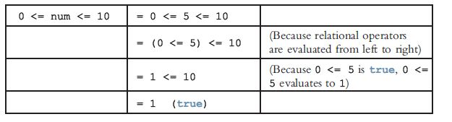
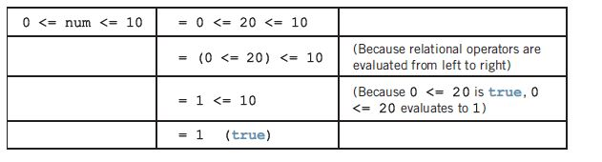
Associativity of Relational Operators: A Precaution (cont’d.)
num = 5
num = 20

Slide 41
Avoiding Bugs by Avoiding Partially Understood Concepts and Techniques
Must use concepts and techniques correctly
Otherwise solution will be either incorrect or deficient
If you do not understand a concept or technique completely
Don’t use it
Save yourself an enormous amount of debugging time

Slide 42
Input Failure and the if Statement
If input stream enters a fail state
All subsequent input statements associated with that stream are ignored
Program continues to execute
May produce erroneous results
Can use if statements to check status of input stream
If stream enters the fail state, include instructions that stop program execution

Slide 43
Confusion Between the Equality (==) and Assignment (=) Operators
C++ allows you to use any expression that can be evaluated to either true or false as an expression in the if statement:
if (x = 5)
cout << "The value is five." << endl;
The appearance of = in place of == resembles a silent killer
It is not a syntax error
It is a logical error

Slide 44
Conditional Operator (?:)
Conditional operator (?:)
Ternary operator: takes 3 arguments
Syntax for the conditional operator:
expression1 ? expression2 : expression3
If expression1 is true, the result of the conditional expression is expression2
Otherwise, the result is expression3
Example: max = (a >= b) ? a : b;

Slide 45
Program Style and Form (Revisited): Indentation
A properly indented program:
Helps you spot and fix errors quickly
Shows the natural grouping of statements
Insert a blank line between statements that are naturally separate
Two commonly used styles for placing braces
On a line by themselves
Or left brace is placed after the expression, and the right brace is on a line by itself

Slide 46
Using Pseudocode to Develop, Test, and Debug a Program
Pseudocode, or just pseudo
Informal mixture of C++ and ordinary language
Helps you quickly develop the correct structure of the program and avoid making common errors
Use a wide range of values in a walk-through to evaluate the program

Slide 47
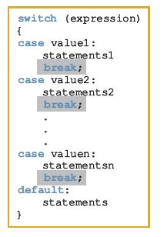
switch Structures
switch structure: alternate to if-else
switch (integral) expression is evaluated first
Value of the expression determines which corresponding action is taken
Expression is sometimes called the selector

Slide 48
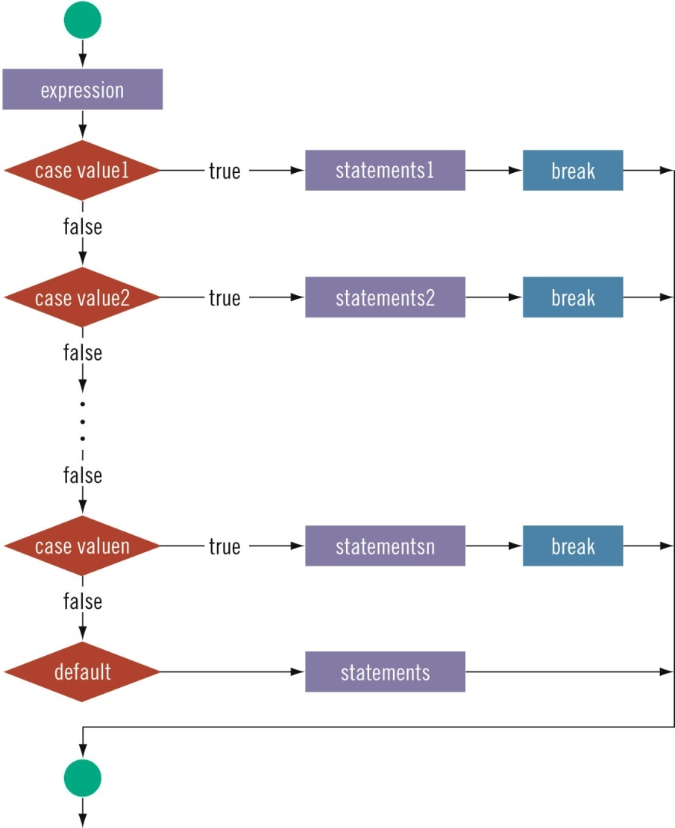

switch Structures (cont’d.)

Slide 49
switch Structures (cont’d.)
One or more statements may follow a case label
Braces are not needed to turn multiple statements into a single compound statement
When a case value is matched, all statements after it execute until a break is encountered
The break statement may or may not appear after each statement
switch, case, break, and default are reserved words

Slide 50
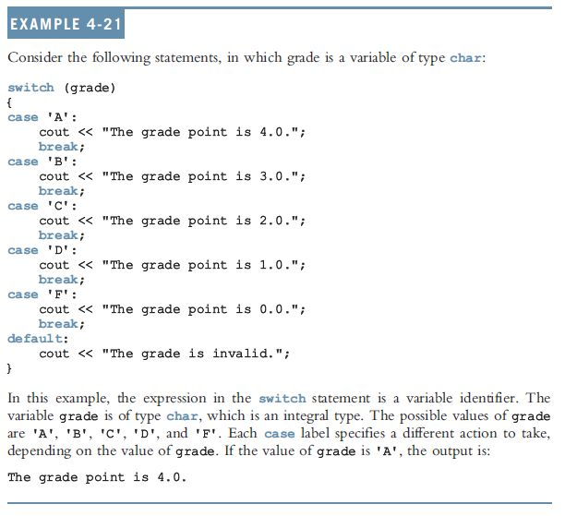
switch Structures (cont’d.)

Slide 51
Avoiding Bugs: Revisited
To output results correctly
Consider whether the switch structure must include a break statement after each cout statement

Slide 52
Terminating a Program with the assert Function
Certain types of errors are very difficult to catch
Example: division by zero
assert function: useful in stopping program execution when certain elusive errors occur

Slide 53

The assert Function (cont’d.)
Syntax:
expression is any logical expression
If expression evaluates to true, the next statement executes
If expression evaluates to false, the program terminates and indicates where in the program the error occurred
To use assert, include cassert header file

Slide 54
The assert Function (cont’d.)
assert is useful for enforcing programming constraints during program development
After developing and testing a program, remove or disable assert statements
The preprocessor directive #define NDEBUG must be placed before the directive #include <cassert> to disable the assert statement

Slide 55
Summary
Control structures alter normal control flow
Most common control structures are selection and repetition
Relational operators: ==, <, <=, >, >=, !=
Logical expressions evaluate to 1 (true) or 0 (false)
Logical operators: ! (not), && (and), || (or)

Slide 56
Summary (cont’d.)
Two selection structures: one-way selection and two-way selection
The expression in an if or if...else structure is usually a logical expression
No stand-alone else statement in C++
Every else has a related if
A sequence of statements enclosed between braces, { and }, is called a compound statement or block of statements

Slide 57
Summary (cont’d.)
Using assignment in place of the equality operator creates a semantic error
switch structure handles multiway selection
break statement ends switch statement
Use assert to terminate a program if certain conditions are not met

